Slide 1
Machine Learning
Machine Learning Introduction to Machine Learning by Kumar Anurupam is licensed under a Creative Commons Attribution-4.0 International License.
PCA - II
CS 3104 Fall 2019
Lecture Slides by Kumar Anurupam

Slide 2
Learning Objectives
After completion of today’s session you will be able to:
Define variance and covariance
Illustrate the algorithm of PCA
Solve any PCA problem

Slide 3
Variance and Covariance
Variance – measure of the deviation from the mean for points in one dimension e.g. heights
Covariance as a measure of how much each of the dimensions vary from the mean with respect to each other.
Covariance is measured between 2 dimensions to see if there is a relationship between the 2 dimensions e.g. number of hours studied & marks obtained
The covariance between one dimension and itself is the variance

Slide 4
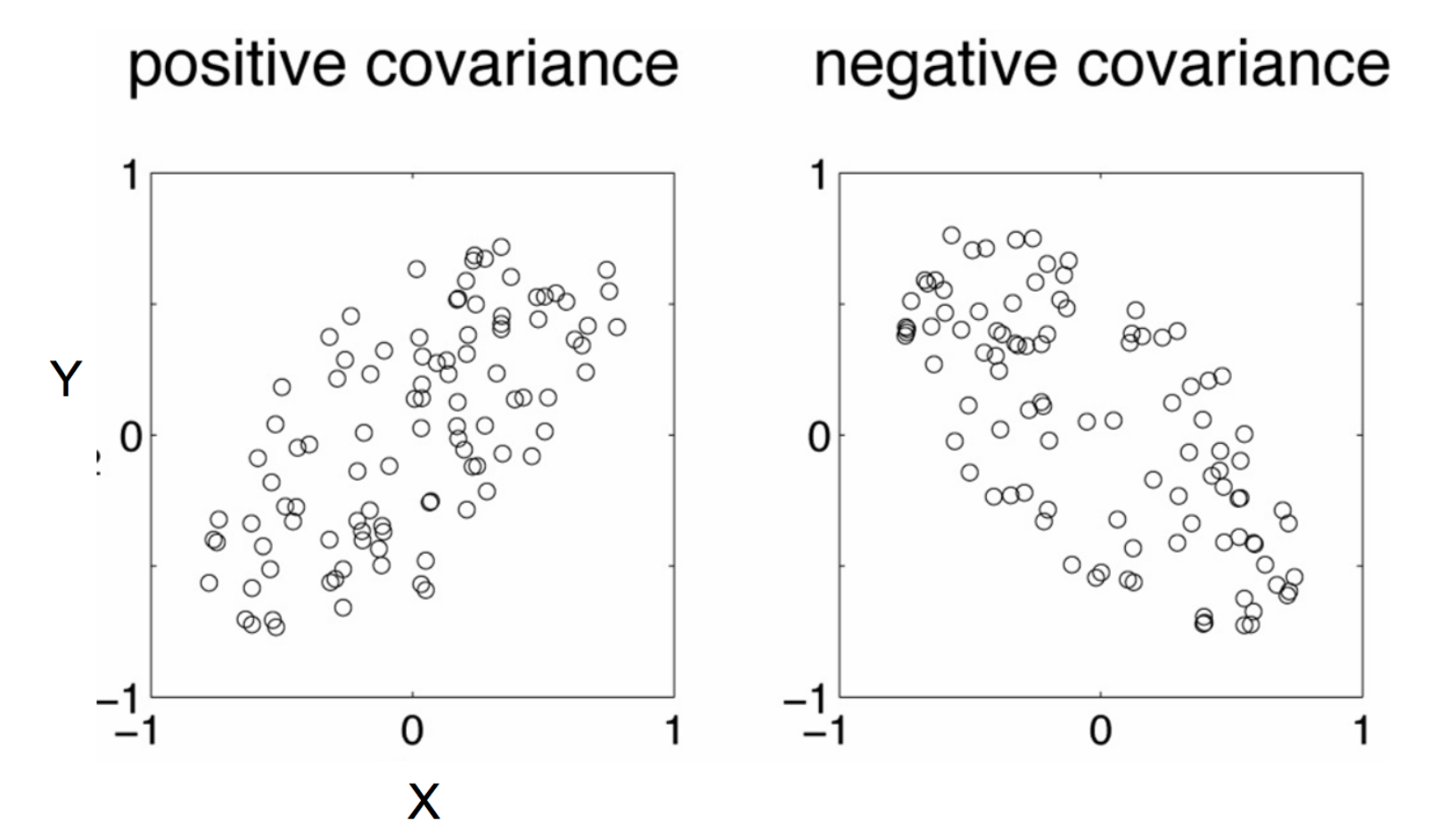
Positive: Both dimensions increase or decrease together
Negative: While one increase the other decrease

Slide 5
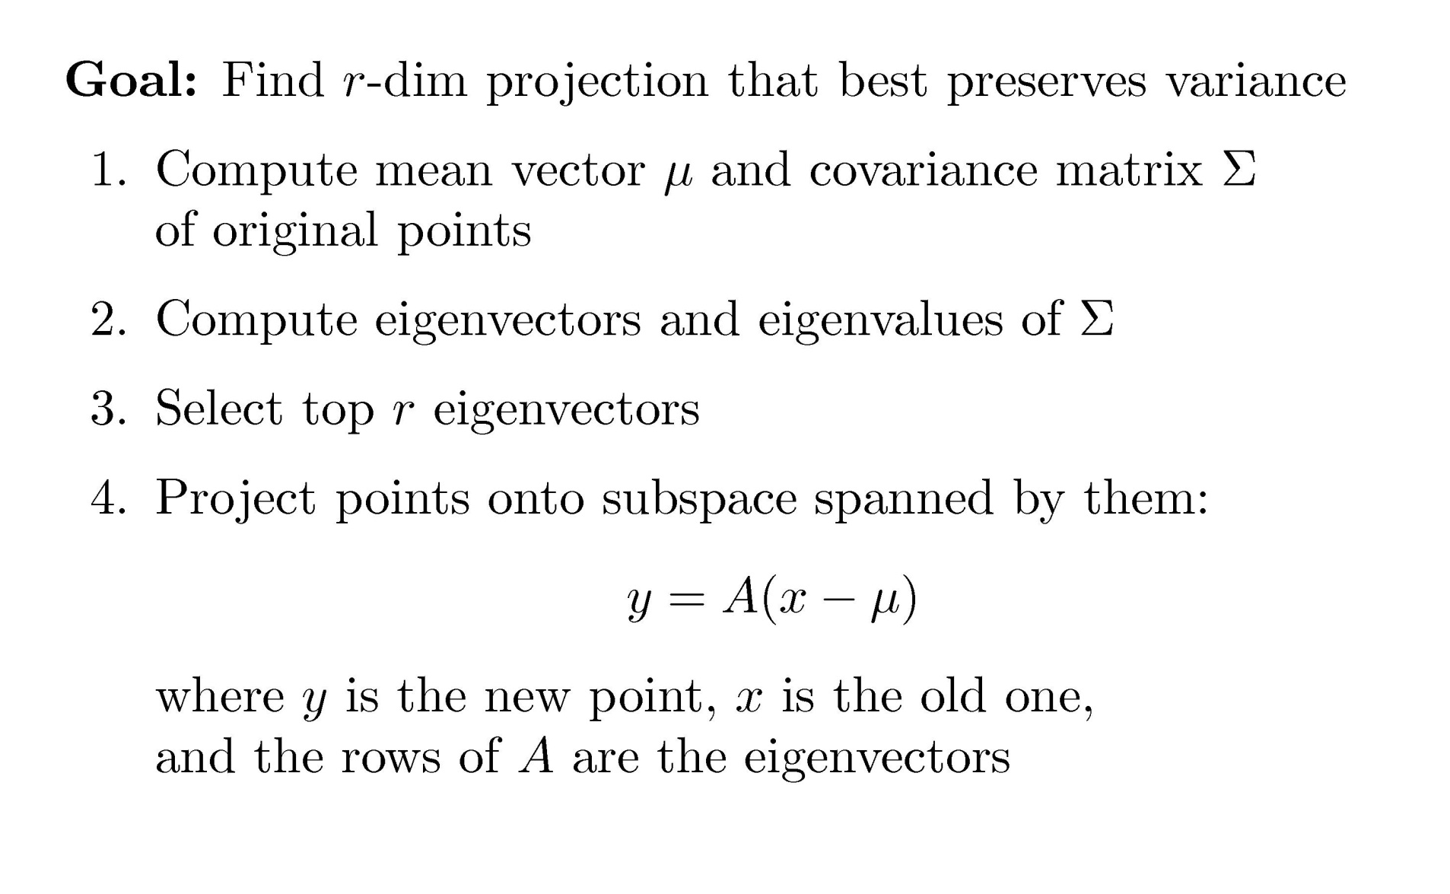
PCA Algorithm

Slide 6
Principle Components
Principal Component (PC1)
The eigenvalue with the largest absolute value will indicate that the data have the largest variance along its eigenvector, the direction along which there is greatest variation
Principal Component (PC2)
the direction with maximum variation left in data, orthogonal to the PC1

Slide 7
Principle Component Variance

Slide 8
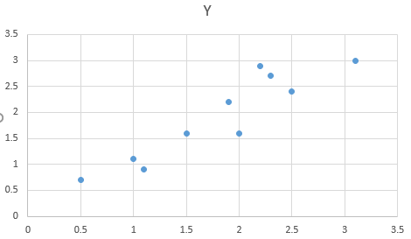
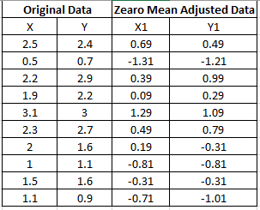
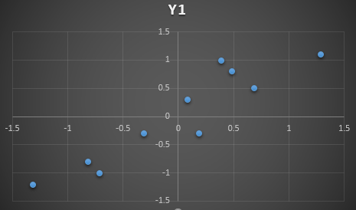
Scatter plot

Slide 10
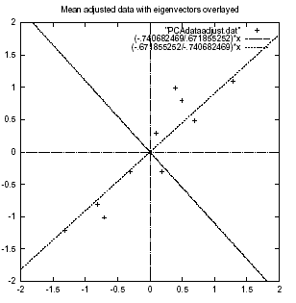
Mean adjusted data with eigen vectors

Slide 11
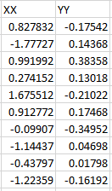
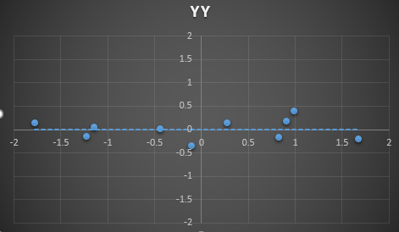
Final values with plotting

Slide 12
References
[1] www.iro.umontreal.ca/~pift6080/H09/documents/papers/pca_tutorial.pdf
[2] https://en.wikipedia.org/wiki/Principal_component_analysis

Slide 13
Thanks

